Slide 1
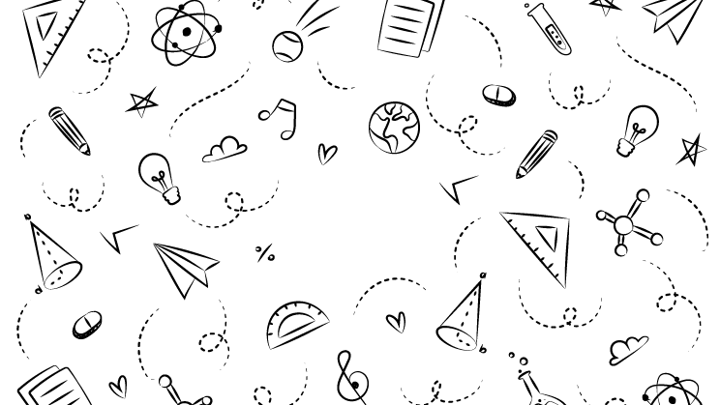



NEXT GEN EMPLOYABILITY PROGRAM
Creating a future-ready workforce
Team Members
College Name
Student Name :u.midhuna varshini
Student ID :au110621104016
Indira institute of engineering and technology -Pandur

Slide 2

CAPSTONE PROJECT SHOWCASE
Project Title
Music Web Application using Django Framework
Abstract | Problem Statement | Project Overview | Proposed Solution | Technology Used | Modelling & Results | Conclusion

Slide 3
Abstract
The Django Music Sharing Application is a web platform designed for music enthusiasts, offering a range of features to discover, upload, share, and collaborate on music tracks. This application, built on the Django framework, presents a user-friendly interface for users to explore a diverse array of music genres, artists, and playlists. Users can create personalized accounts, complete with customizable profiles to manage their music preferences. The platform hosts an extensive music library containing songs spanning various genres, albums, and artists, allowing users to effortlessly search, filter, and delve into music tracks of their interest.
In addition to streaming music tracks, the application provides users with the convenience of downloading their favorite songs for offline listening. Social integration features are seamlessly integrated, allowing users to connect with friends, follow their favorite artists, and discover new music through shared connections. Sharing music on popular social media platforms is made simple and intuitive
Django Music Sharing Application aims to create a vibrant and interactive music-sharing platform where artists, musicians, and music enthusiasts can connect, discover new music, and collaborate on creative projects. With its robust set of features and user-friendly design, the platform offers a rich music experience for all its users, enhancing the way music is shared and enjoyed in the digital age.
Source :

Slide 4
Problem Statement
The music industry lacks a comprehensive and user-friendly platform for artists to share their music and for enthusiasts to discover new tracks and engage with a community. Existing music-sharing platforms often fall short in providing a seamless experience for musicians to upload, receive feedback, and collaborate on music, while also limiting the ability for users to explore diverse genres, curate playlists, and connect with fellow music lovers. This project addresses these gaps by developing the Django Music Sharing Application. This platform will empower artists to showcase their work, collaborate with others, and gain exposure, while offering music enthusiasts a vast library of tracks, curated playlists, and social features for discovering and sharing music effortlessly.
Source :

Slide 5
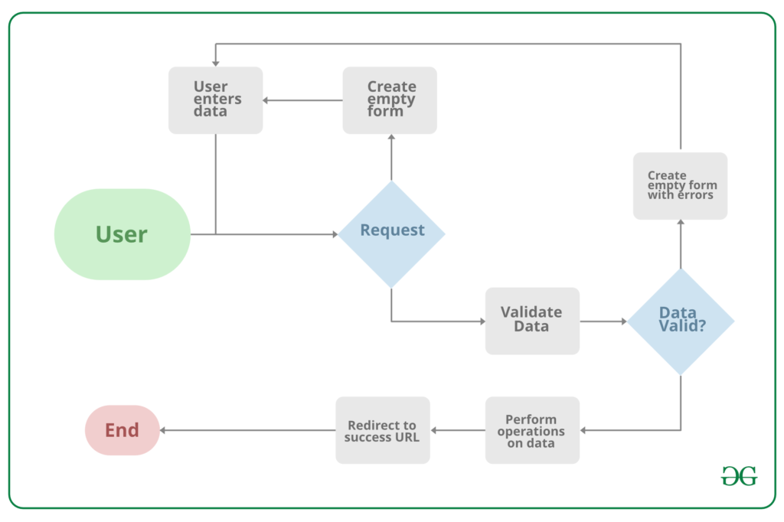
Project Overview
Source :google

Slide 6
Proposed Solution
The proposed solution is to develop Django Music Sharing Application aims to bridge the gap in the music industry by offering a robust and user-centric platform for artists and music enthusiasts alike. For artists, the platform provides an intuitive interface to upload and share their music, create profiles, and receive feedback from a community of fellow musicians and fans.
Key features include a user-friendly music player with customizable playlists, social sharing options, comment sections for tracks, artist profiles with bios and discographies, and a newsfeed showcasing the latest releases and updates. The platform's responsive design ensures seamless access from desktop and mobile devices, enhancing user experience and accessibility.
System Architecture
Backend Development: Utilize Django for robust server-side logic, database management, user authentication, and session management, ensuring a secure and efficient backend structure.
Frontend Integration: Employ HTML, CSS, and JavaScript alongside Django's template system to create an intuitive and responsive user interface, enhancing user experience across devices.
Database Design: Develop a relational database schema to efficiently store user profiles, music tracks, playlists, comments, and interactions, enabling quick retrieval and secure storage of data.
2 .Core Features:
User Profiles: Allow artists to create detailed profiles with bio, discography, and social media links.
.
Source : GPT 4

Slide 7
Security and Privacy:
Implementation of Django’s security best practices to mitigate common vulnerabilities like SQL injection, XSS, and CSRF.
Adherence to data privacy regulations such as GDPR to safeguard user's personal information.
Scalability and Performance:
Designing the application with scalability in mind, allowing for seamless adaptation to increased user numbers and data volume.
Utilization of Django’s caching framework to improve application performance and reduce server load.
User Experience (UX) Design:
A user-centered design approach to create an intuitive and engaging platform that meets the needs of musicians and music enthusiasts.
Responsive design principles to ensure accessibility across various devices and screen sizes.
Testing and Quality Assurance:
Thorough testing, including unit tests, integration tests, and user acceptance testing (UAT), to ensure reliability, security, and user-friendliness.
Utilization of Django’s testing framework to automate test cases and maintain code integrity.
Source :GPT 4

Slide 8


Technology Used
Front-end
Back-end
Source :

Slide 9
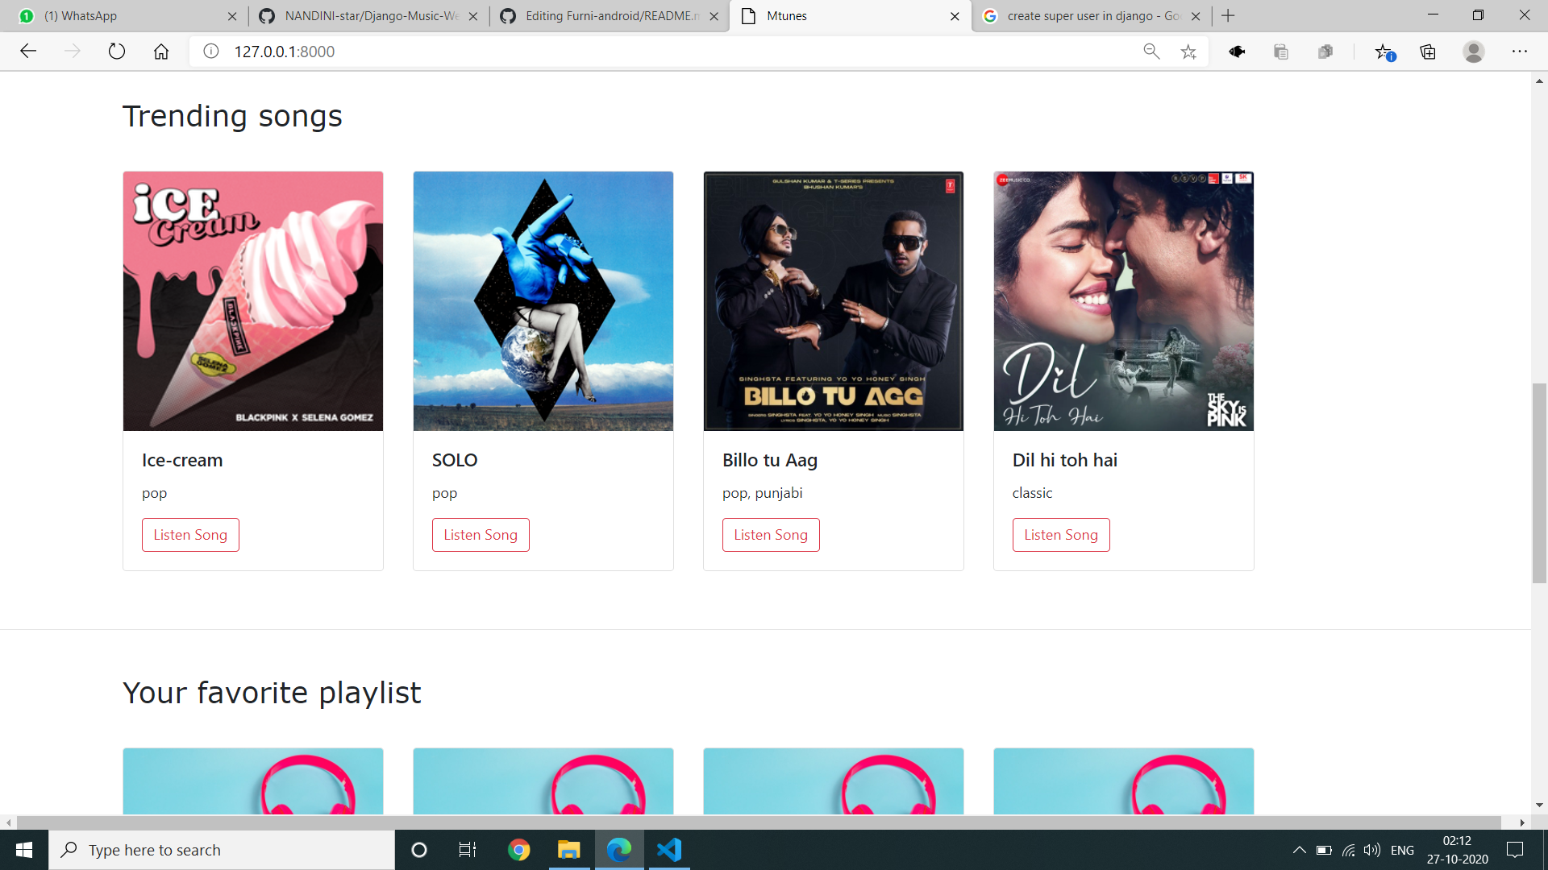
Modelling & Results
Source :

Slide 10
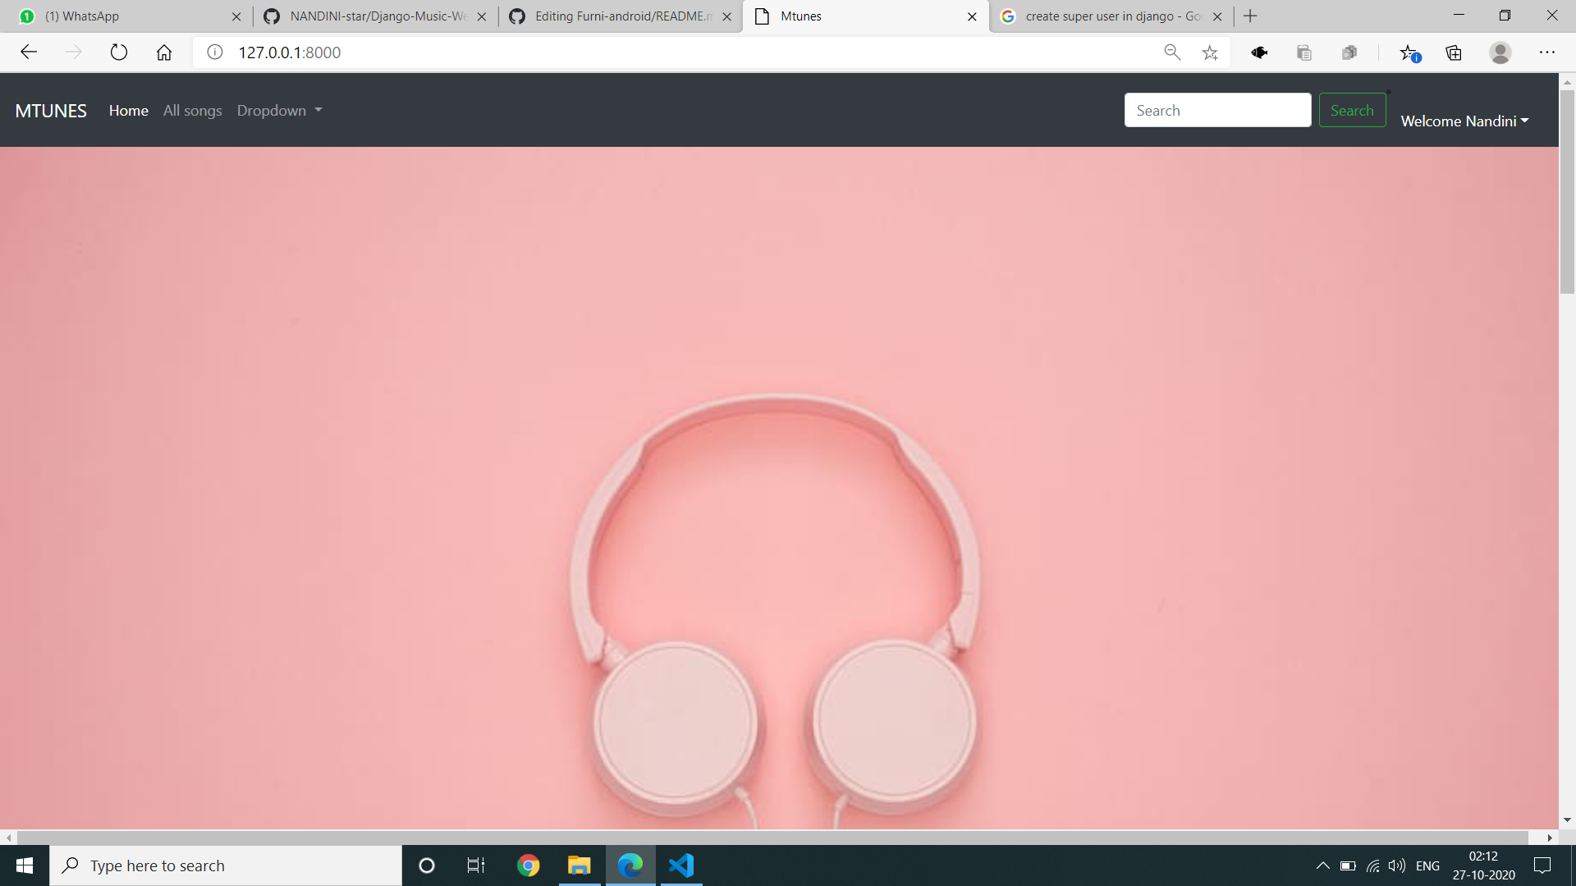
Homepage

Slide 11
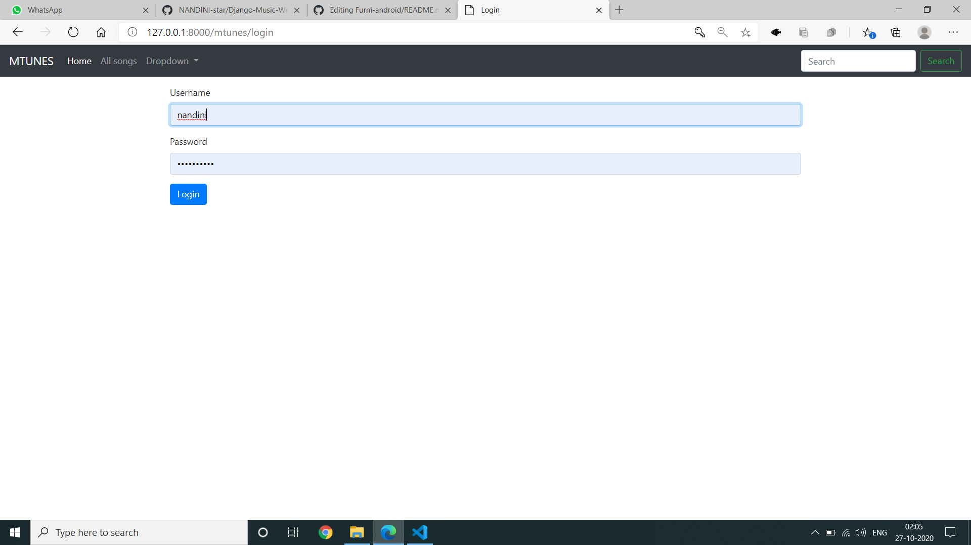
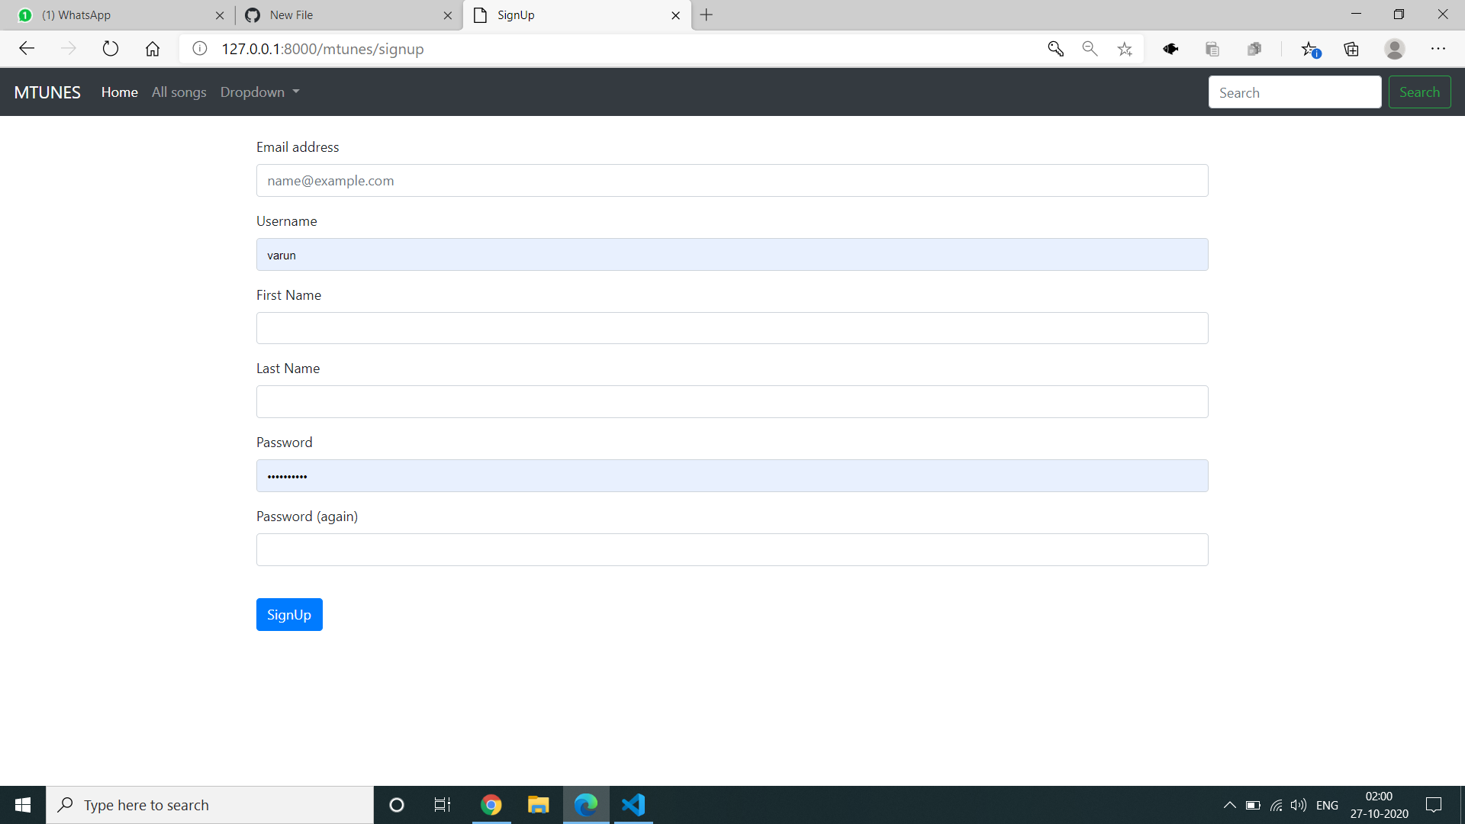
Log in /Sign up page

Slide 12
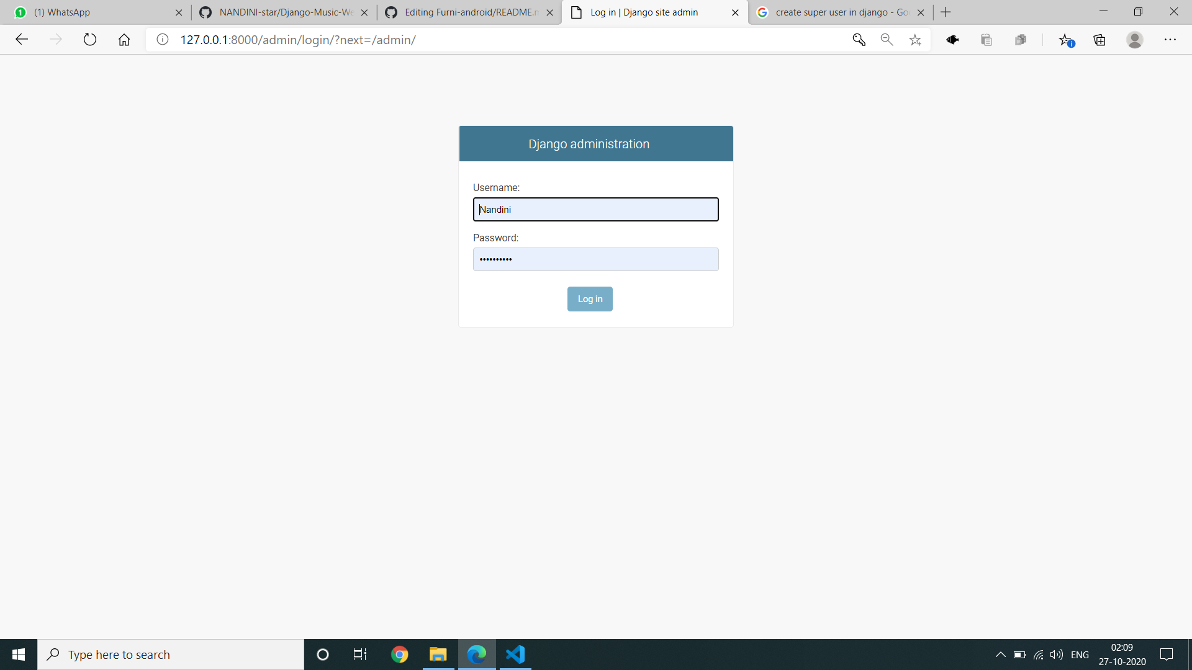
Admin-Page

Slide 13
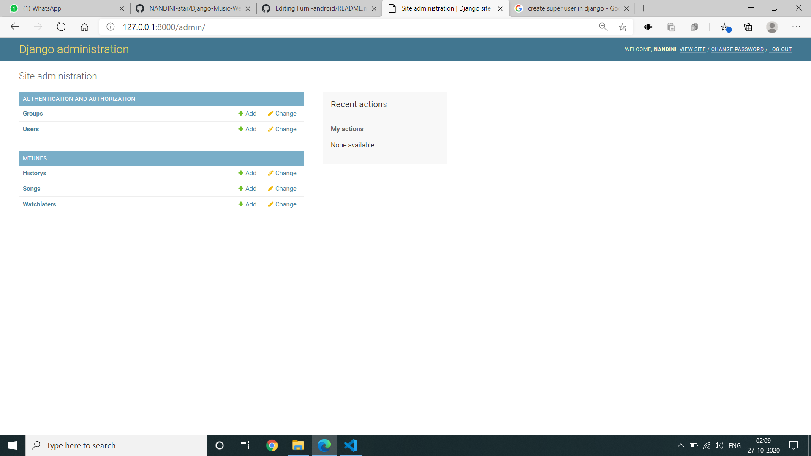
Admin home-Page

Slide 14
Future Enhancements:
1. Artificial Intelligence and Machine Learning Integration
Content Recommendation System: Implement machine learning algorithms to analyze user behavior, preferences, and interactions with the content to provide personalized Song recommendations.
Automatic Categorization: Utilize natural language processing (NLP) techniques to automatically categorize Song based on their content, making the upload process more efficient and improving the discoverability of resources.
2. Enhanced Collaboration Features
Real-Time Collaboration: Introduce real-time editing and commenting features
Community Groups: Enable users to create and join groups within the application, fostering a more organized and vibrant environment.
3. Integration with External Platforms
Cloud Storage Services: Offer integration with cloud storage platforms to allow users to easily upload and backup their Songs.
Educational Tools and Platforms: Integrate with other educational platforms and tools, providing a seamless experience for users to access a wide range of resources and tools from within the application.

Slide 15
Conclusion
In conclusion, the Django Music Sharing Application presents a robust and feature-rich platform tailored for musicians and music enthusiasts to connect, share, and discover music in an interactive environment. By leveraging the Django framework's capabilities, the application ensures a secure, scalable, and user-friendly experience.
The emphasis on security and privacy measures, including Django's built-in security features and compliance with data privacy regulations like GDPR, instills confidence in users that their personal information and interactions are protected. Additionally, the application's design prioritizes scalability and performance, allowing it to adapt seamlessly to growing user bases and increased data volumes while maintaining optimal performance levels.
Through comprehensive testing and quality assurance practices, including automated testing with Django's testing framework, the application's reliability, security, and user-friendliness are thoroughly vetted. This ensures a seamless and enjoyable experience for users as they navigate, share, and collaborate within the music-sharing community.
Overall, the Django Music Sharing Application stands as a testament to modern web development practices, offering a dynamic and vibrant platform for music lovers to connect, share their creations, and explore the diverse world of music.
Source :

Slide 16
Thank You!
Notes:
Thank You !!

